Slide 1
Notes to the Speaker
The purpose of this talk is to inspire the Computer Science student audience. We want them to walk away with a practical application towards what they are learning as developers and technology decision-makers of the future. A talk like this helps build their conceptual knowledge of cybersecurity, how computer scientists might approach solving key technical problems. It also might increase their interest in pursuing a career in cybersecurity too.
The overall feel of the presentation should be to:
Connect the subject matter to the audience. Make it personal for them so that they can identify with it. Tell them a story!
Narrate the stories so that the audience can get caught up in them. This helps to anchor the thoughts
Explain the concepts by making them reachable no matter what the educational level. Use metaphors and introduce concepts one by one.
Persuade the audience that cybercrime is a real issue and that the right people to help to solve the crimes are right in front of you! You can do this through stirring their curiosity and reminding them that they are in the right field of study to enter the arena of the White Hats.
Revelation! Use all of your stories and metaphors in this talk to reinforce the throughline (the point that we keep coming back to in this talk) – that this audience is part of the solution to all that puzzles us about cybersecurity.
Speakers should review reference materials, read recent news articles of cybercrime, and technical solutions in order to for Q&A to be as beneficial as possible.
LOCALIZATION NOTES:
Feel free to change the initial slide to reflect a fictionalized and popular theft that will make the point to your audience. We want to draw the line between fact and fictionalized crime.
If you have a locally popular cyber crime news story, please add it or substitute it in the presentation, as well.
Guidelines:
Please do not use corporate logos from Amazon, Apple, major retailers, etc.
Please do not outwardly disparage any entity as a result of a cyber incident
Include Microsoft technology information where possible.
Presentation intended for 60 minutes with some Q&A; please edit according to available time.

Slide 2
Cybersecurity, an ever-moving target
<insert your name>
<Technical Evangelist>

Slide 3


Highly orchestrated gang robs a bank with guns
$75M
USD stolen
Notes:
Who has seen <INSERT APPROPRIATE LOCALIZED EXAMPLE HERE & movie poster in slide> Ocean’s Eleven?
For those that haven’t: it was a remake of a 1960 film of the same name, and starred George Clooney. Brad Pitt, Matt Damon and Julia Roberts (just to name a few of the cast).
The heist depicted in the film involved: a violated parole, a simultaneous theft of 3 casinos, revenge, a love triangle, an EMP machine, a circus acrobat, a faked heart attack and a duplicate vault. In the end, the heist is pulled off and they escape with $75M USD, and the bad guy loses the girl to the good guy (who serves 3-6 months in prison for breaking his parole).
Crime is depicted by Hollywood to be one thing, when we know that it really is a very different type of process. There can be far less drama, and a much more drawn out timeline, before a theft is successfully completed. It can be a silent event that no one knows is happening until it’s too late.
Today I want to talk to you about Cybersecurity. Merriam-Webster’s dictionary definition is “measures taken to protect a computer or computer system (as on the Internet) against unauthorized access or attack.” But I like to think of it as a puzzle to be solved. What if I told you that it’s possible for me to have a very small piece of hardware up here and trick your cellphone into thinking that it’s connecting to the local Starbucks free wi-fi? Right here. Right now.
So you sit tight, while I have my hacker friends scan their targets: your laptops, smartphones and tablets for any personal information.
<PAUSE>
I DON’T have anything with me other than my laptop. But, if I did – would you even have realized it in the past few minutes? Did you realize that you were a target. Is there any way to make your technology less detectable, maybe even invisible? We need help. A lot of help in this area. The prevention of a hack is a problem to be solved that has wide repercussions and innumerable benefits.
You can be the one to create an invisible target through a career in cybersecurity. Can you solve the puzzle?

Slide 4

Russian Carbanak Group pulls off biggest bank heist in history
$1B
USD stolen
Notes:
In a few minutes we will discuss a true story about a billion dollar bank heist. There was no dramatic standoff, no one holding up a teller. Just emails being opened by unsuspecting employees, resulting in ATMs dispensing cash on demand and bank account balances being redistributed to other dummy accounts. Over a period of almost two years. Undetected.
Think about that.
That means, for the duration of your freshman and sophomore year here at school. There could have been someone siphoning off a few cents from your bank account here and there. Except it wasn’t a typical bank account. It was one in which up to $10k USD at a time was moved from point A to point B. And point B was unrecoverable. It was invisible.

Slide 5
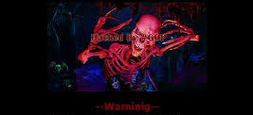
When Sony Pictures was hacked
In 2014, Sony Pictures was hacked by North Korea in attempt to stop the release of the movie, “The Interview”
Timeline of Events
Sony receives email from “God’s Apostles”
Wiper activates
“Guardians of Peace” claim credit and release movies
FBI sends flash alert
Destover Malware detected
'Warning: We've already warned you, and this is just a beginning. We continue till our request be met. We've obtained all your internal data including your secrets and top secret.'
GOP release Sony Exec emails
Sony gets lawsuit for not protecting client data
Sony cancels movie release, The Interview
FBI blames North Korea due to IP addresses of hackers
OUTCOMES
Reputation
Damaged
Financial
Implications
Company Secrets Revealed
Notes:
Imagine logging into your laptop in the morning, and the first thing you see is a creepy red skeleton with these words underneath: 'Warning: We've already warned you, and this is just a beginning. We continue till our request be met. We've obtained all your internal data including your secrets and top secret.'
What do you do next?
Fortune magazine called this “The Hack of the Century” – from their article: “…starting at about 7 a.m. Pacific time on Monday, Nov. 24—a crushing cyberattack was launched on Sony Pictures. Employees logging on to its network were met with the sound of gunfire, scrolling threats, and the menacing image of a fiery skeleton looming over the tiny zombified heads of the studio’s top two executives.” The malware they released “ …erased everything stored on 3,262 of the company’s 6,797 personal computers and 837 of its 1,555 servers. To make sure nothing could be recovered, the attackers had even added a little extra poison: a special deleting algorithm that overwrote the data seven different ways. When that was done, the code zapped each computer’s startup software, rendering the machines brain-dead.”
All in all, the hackers stole and then released executive emails providing details that those executives never meant for anyone other than their intended recipients. They certainly never meant their comments for public consumption. The hackers also stole payroll and Social Security information on employees, movie scripts and unreleased films!
The reputational damage that Sony suffered was fantastic. On Dec 12, the US federal government blamed N Korea for the hack. Sony received zero support from the Hollywood community, loss of it’s employees’ trust, who were now being threatened with identity theft.

Slide 6
Cybersecurity … why does it matter?
Notes:
So, what does this mean to you? You aren’t a multinational corporation, and you change your passwords frequently, right?

Slide 7
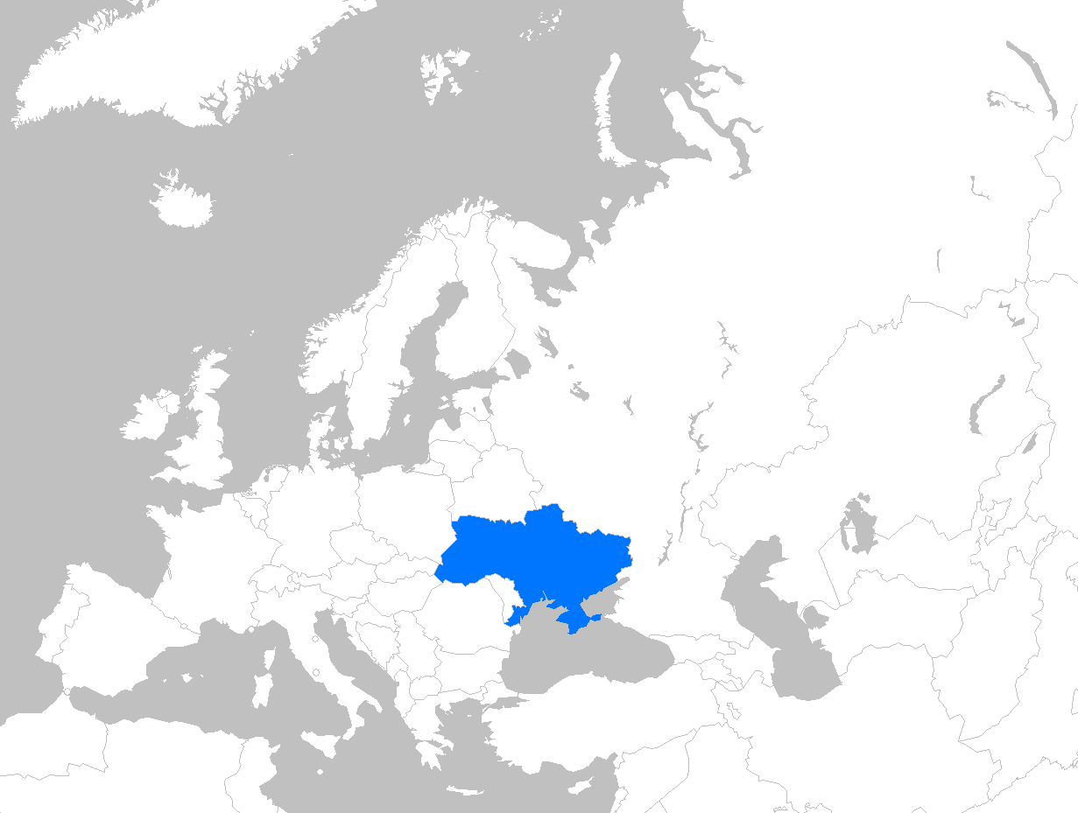


The story of a 20-year-old Ukrainian hacker
Maksym Igor Popov started as a black hat in the Ukraine
In 2001, his journey to joining the ‘good side’ and become a white hat led him to the United States
…but the story didn’t play out the way he expected it to.
Notes:
<<for the TE: Article for more backstory: https://www.wired.com/2016/05/maksym-igor-popov-fbi/ >>
Meet Maksym Igor Popov, a Black Hat from the Ukraine. At 20 years old, he sought asylum in the United States. He’d already accumulated enough enemies in his native country that he felt it would be best to leave, start a new life, help catch hackers just like him and get rich doing it.
The reality was, although the US accepted his request, the feds (the Federal Bureau of Investigation, or the FBI) arrested him upon arriving on US soil for his part in the extortion and fraud of some large US companies, and instructed him to either work for the FBI to help capture more like him, or serve time in prison.
At first, Maksym chose to “help” the FBI be working for them as an informant; he’d log into hacker chat rooms and let the FBI know what was going on. I say “help” because for three months, he used popular expressions in Russian to warn his friends that he was being forced to spy on them for the US authorities. Once the FBI caught on, however, Popov was brought up on charges and then about to be sent to jail to serve out his term.
A single FBI agent believed that Popov could still be of help, however. Instead of turning in his friends, he’d find hackers that he didn’t know and trick them into getting caught, instead of having to turn in people he knew. He’d sleep in his jail cell, and during the day be taken offsite to what would be called “Ant City” to bait other hackers into various traps and be caught by US authorities.
Eventually, his 2 year prison sentence ended, and he tried his hand at making a life in the US, only to give up and return home.
He helped to solve some of the puzzle: Eastern European hackers just wanted a job – and in designing elaborate schemes around offers of employment to the hackers he targeted, he was able to help US officials make arrests and save millions of dollars in possible theft.

Slide 8

Let me introduce you to Sarah, a 3rd year university student.
Notes:
So what do a 20-year old Ukranian hacker and you have in common. Let’s take an example. This is Sarah: she’s your average computer science major with a decent social media presence, lots of good friends and a volunteer in the university community. She’s looking for the perfect internship to get a job right after graduation.
On the way out of her CS 121 <for HARVARD> final, ready to pack up and go on break, she checks FB. She notices some strange posts, but her friend John calls her to see how she did. A few hours later, on the train home, she then checks her Twitter feed and notices more strange posts. And then she checks her LinkedIn profile, it lists activities and interest that have nothing to do with her. Sarah has been hacked. She launches into a complete panic, knowing that as a part of the background check for her internship, the recruiters will be looking at her FB and Twitter feeds and her LinkedIn profile!! She’s completely panicked. How could this have happened? She majors in Computer Science!!
What would you do the very first time this happened to you?

Slide 9
The Value of a Hacked Device
Once a network is penetrated, hackers find value across many areas, incl. financial and nonfinancial
Web Server
Bot Activity
Phishing
Malware
Warez
Spam Site
Anonymization Proxy
Click fraud zombie
DDoS Extortion zombie
Email Attacks
Account Credentials
Webmail Spam
Harvest email contacts
Corporate email
Skype credentials
Website FTP credentials
eBay auctions
Virtual Goods
Financial Credentials
Online gaming characters
Operating system license key
Bank account
Stock trading
401K/investments
Reputation Hijacking
Hostage Accounts
Facebook
Google +
LinkedIn
Ransomware
Webcam image extortion
Fake antivirus
Notes:
Why would anyone want to hack into Sara’s laptop or other device? There are a variety of ways that a device can be used to do less than legal hacks.

Slide 10
This is not an isolated problem
Cyberattacks are a global problem and expand across all industries
89%
of breaches had a financial or espionage motive
205 days
avg. days of malware before detection
20% ➜ 60%
By 2020, 60% of enterprise information security budgets will be allocated for rapid detection and response approaches, up from less than 20% in 2015
Attacks occur across most industries regardless of company size
Notes:
Cybersecurity is a need at all levels, from your tablet and smartphone up to the multinational corporation. The statistics are alarming:
According to Juniper Research, the cost of cyber crime is expected to be $2 Trillion by 2019. According to Microsoft, 20% of small to mid sized businesses have been cyber crime targets.

Slide 11
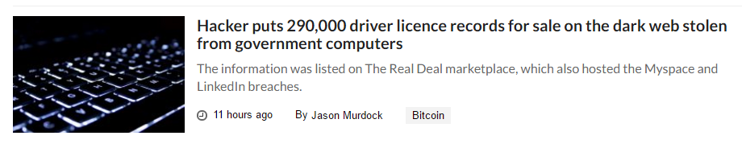
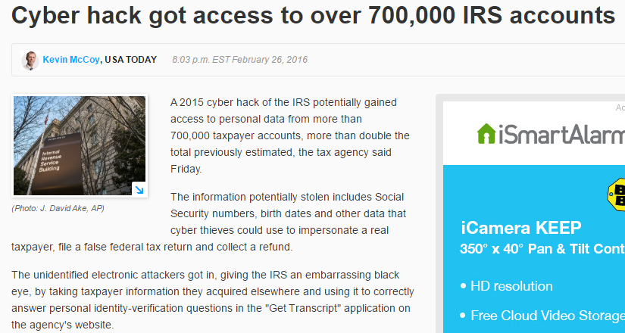
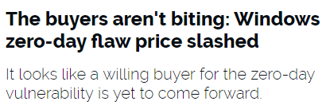
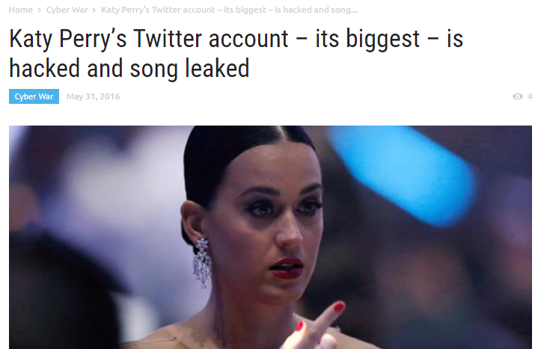
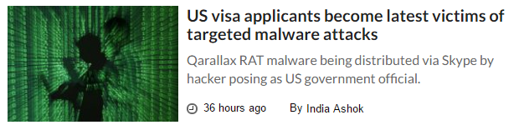
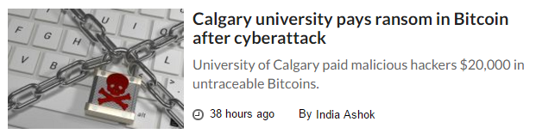
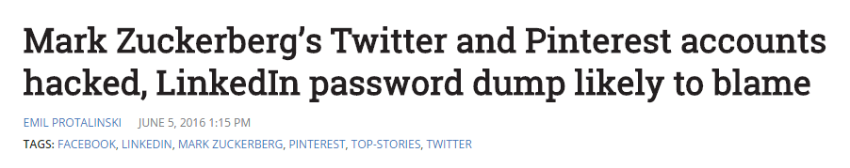
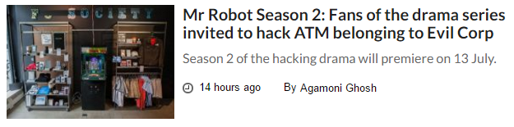
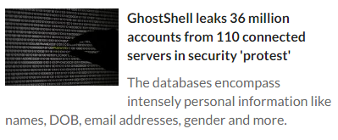
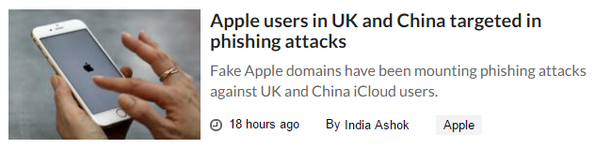
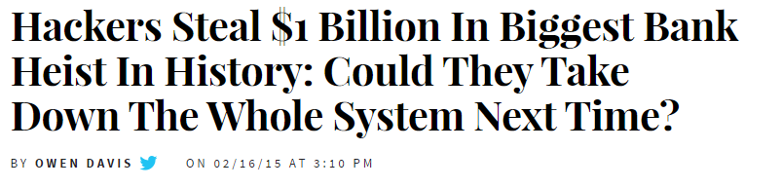
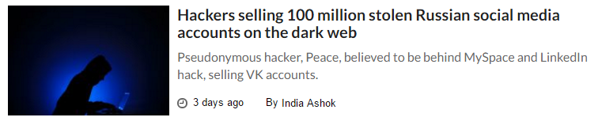
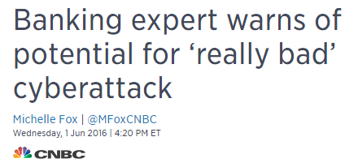
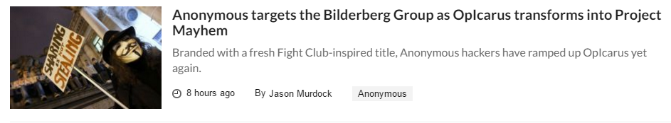
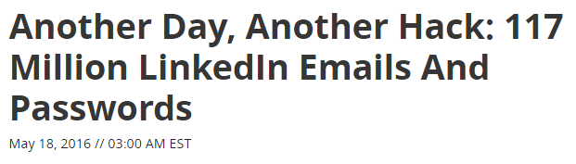
This is happening everyday, everywhere
Notes:
Check Wired, The Hacker News or any national news outlet. Cyber crime happens every single day. There are hundreds of thousands of new individual computer viruses popping up today, and tens of thousands of websites becoming infected.
We use computers everywhere, all of the time. Medical records, bank accounts, car loans, credit cards, your class schedule and grades, your car, the planes and trains we travel in…. All store your personal or operational data. We can’t get away from a data-centric life. And that data has value to criminals. Credit histories, professional achievements, and academic records can be manipulated to create new identities and ruin the individual history from which they were stolen.
This problem is invasive and expensive and we desperately, as individuals and collectively, need someone to solve the enigma: how do we get ahead of attacks before they happen? How do we out-think the hacker society before they out think our security measures?

Slide 12
…but there is a bright side: Opportunity
Currently, there are 1 million cybersecurity job openings globally
On average, cybersecurity professionals receive compensation of 9% more than other IT workers
The market for cybersecurity is expected to grow 350% by 2020
Notes:
“To combat the growing number of and evolving threat of cyber attacks, businesses across all industries and geographies are looking to….”
More than 209,000 cybersecurity jobs in the U.S. are unfilled, and postings are up 74% over the past five years, according to a 2015 analysis of numbers from the Bureau of Labor Statistics by Peninsula Press, a project of the Stanford University Journalism Program.
A report from Cisco puts the global figure at one million cybersecurity job openings. Demand is expected to rise to 6 million globally by 2019, with a projected shortfall of 1.5 million, says Michael Brown, CEO at Symantec, the world’s largest security software vendor. It looks like solving the puzzle is financially lucrative!
We need to identify who is going to help fill these positions. Could it be you? We hope so. We want and desperately need highly trained investigators who have the knowledge of systems, code, app development … but there is no clear path, no certifications and very few university-level specialization opportunities for education.
This is another puzzle to be solved!

Slide 13

The Right Person for Cybersecurity
Loves solving puzzles
Exhibits curiosity
Willing
to be a
Super Hero
Adapts
to change
Notes:
Cyber security involves a whole wealth of talents, from synthesizing all sorts of different types of information, to the development of algorithms and creative code. To be effective, you need to be part sleuth and part innovator, detail oriented and collaborative. Education is important, but that’s just the start: you will be learning something new every day.
Who is the perfect fit? Studying computer science is a great start. Studying data science, structures and algorithms will give you the foundation, but there is a lot to learn on the job. Part of that job will be consistently learning and problem solving to get in front of a potential issue or find the root cause.
Curiosity is the driver behind successful investigators. It’s what keeps you asking the why’s and learning more and more about the situation. Do you find yourself unsatisfied with an easy explanation for a complex problem? Are you constantly looking for another angle to a problem and it’s solution?
The cybersleuth is also going to be adaptable – he or she will be able to adapt to the constantly changing environment. There is nothing static about the hacker intellect – they are pushing for new and innovative ways to disrupt the norm, steal and control their targets. How quickly do you think? Can you change direction quickly?
We need some super heroes: we need you to be the next great cybersleuth and visionaries. There are going to be opportunities for you to save people from identity and financial theft, to develop protection from the bad guys. To work tirelessly for those you will never meet to create a secure and safe environment for all. Are you our next super hero?

Slide 14



Black & White Hats
There are two types of hackers: the bad and the good
Black Hats
White Hats
Black Hats break things
Intent is malicious
Reasons could include:
Financial (89% of all hacks)
Espionage
Ideology
Grudge
White Hats build things
Ethical Hacking
Works in teams referred to as sneakers, red teams, or tiger teams
Some White Hats pursue bounties on discovering organization vulnerabilities
Notes:
Black hats are the troublemakers. They wreck havoc, cause disruption, steal and electronically deface with malicious intent.
Sometimes it is a single hacker and sometimes it’s the result of a hacking society like Anonymous. If you’ve not heard of them yet, they are a hacking society that practices a concept called “Hacktivism”, or activism via hacking – hacking for a cause that they deem important to better or protect society. They are made up of a group of anonymous hackers spread across multiple countries and continents. They’ve been responsible for both network hacks and in person protests.
The common weapon of the hacktivist is a Distributed Denial of Service (DDoS) attack, which bombards the target servers with thousands of page requests (similar to masses of people sitting on the site and continually pressing refresh), eventually overloading and crashing the site It’s similar to a virtual sit-in; it’s not destructive, instead it’s more of a disruption of service causing annoyance instead of theft. Any potential user would be unable to access the site, creating a disruption in the user experience and normalcy of operations.
The other side of hacking is made up of legitimate and legal hackers – cyber security experts – that work to block the hackers’ work and ensure the integrity and security of an organization's systems. This is the side of the equation that we like to focus on and the reason that I am talking to you today. White hats are employed by just about every corporation, government and the military. The US military academies have been developing their cyber security curriculums and skills and participating in competitions with a us security agency for the past 15 years!

Slide 15

Bounties for the White Hats
Companies and gov’ts now offer bounties for hackers to identify vulnerabilities
Common bounty programs
The Pentagon (Hack the Pentagon Program)
Facebook
Google
Apple
White Hats race to find bugs and other vulnerabilities for monetary reward
Notes:
https://hackerone.com/about#_
It’s become commonplace for both businesses and governments to partially outsource their testing of bugs and vulnerability to the hacking community. “Good” hackers will look for bugs and entry points into an enterprise. In return, a “bounty” is paid when a vulnerability is discovered. HackerOne was created by security leaders from some of the worlds largest companies to more efficiently connect businesses with the hacking community. More info: https://hackerone.com/resources/bug-bounty-basics
In 2013, Google offered large rewards for Chrome OS Hacking Contest. Mozilla has paid out over a million in awards in their Bug Bounty Program. Microsoft offers direct payouts for reporting certain types of bugs and vulnerabilities in Windows, Internet Explorer, and Microsoft Edge. Their program expanded to include their Azure (cloud) platform in 2015 which uses and support a wide range of cross-platform and open source technologies. It pays to be a white hat!

Slide 16
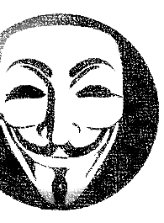
The Dark Web, a playground for Black Hats
While the Dark Web isn’t solely for criminal activity, it’s attractive to cybercriminals
Attributes of the dark web
Unsearchable world wide web that requires specific software and authentications to access.
Consists of encrypted peer-to-peer networks.
Criminals use these networks due to the anonymity
Notes:
The Dark Web is defined as the encrypted network that sits between Tor (an encryption tool) servers and their clients. Though the websites are publicly visible, the IP addresses of the servers that run these sites are hidden, with their locations spoofed. Not all Dark Web sites use Tor. Some use similar services such as I2P - Silk Road Reloaded uses this service. But the principle remains the same. The visitor has to use the same encryption tool as the site and - crucially - know where to find the site, in order to type in the URL and visit.
There is one layer deeper: The 'Deep Web' refers to all web pages that search engines cannot find. Thus the 'Deep Web' includes the 'Dark Web', but also includes all user databases, webmail pages, registration-required web forums, and pages behind paywalls. There are huge numbers of such pages, and most exist for mundane reasons.

Slide 17

Bitcoin, a currency of the Dark Web
What is it?
Why and how do hackers target Bitcoin?
A virtual currency that uses block chains for digital payments.
Because Bitcoin is unregulated and complex in nature to the general consumer, hackers will target bitcoin holders
Main Features
Several methods exist on how to steal bitcoins; the most typical way is hacking into a computer via phishing and taking bitcoins without notice from the holder
Anonymous transactions
Decentralized
Global
100% digital
Based on Sha-256 hash
Bitcoin holders have no recourse after the hack because of the lack of tracing ability with the currency
Notes:
One of the primary currencies of the dark web is Bitcoin for the same reasons that criminals prefer to use the dark web: it’s anonymous and untraceable. Using bitcoins, buyers can purchase illegal items with less fear of getting caught given that a financial trail doesn’t exist. Several sites operate as exchanges for buying and selling of illegal products and services with bitcoin as the method of payment.
Because a trail doesn’t exist (and given that the currency is completely stored digitally) hackers will target bitcoin holders for theft purposes. If hackers are able to steal bitcoins successfully, it will be nearly impossible to recapture the currency given the lack of a financial trail.
As an unregulated currency, mining/trading sites as well as virtual currency platforms do not have standardized security measures. People have mined unauthorized bitcoins and hacked bitcoin users.
Malware exists specifically to target bitcoin holders, stealing the currency
Example bitcoin sites
Bit-miner.com: Bitcoin mining site
Bitcoin.org: Bitcoin’s main website
Mining.bitcoin.cz: Bitcoin mining site
Bitcoin-trade.biz: Bitcoin trading site
Payoneer.com: Payment platform called Payoneer
Perfectmoney.com: Virtual currency called Perfect Money (PM)
Qiwi.ru: Virtual currency called QIWI
Webmoney.ru: WebMoney (WM), a virtual currency
Money.yandex.ru: Yandex Money, a virtual currency

Slide 18
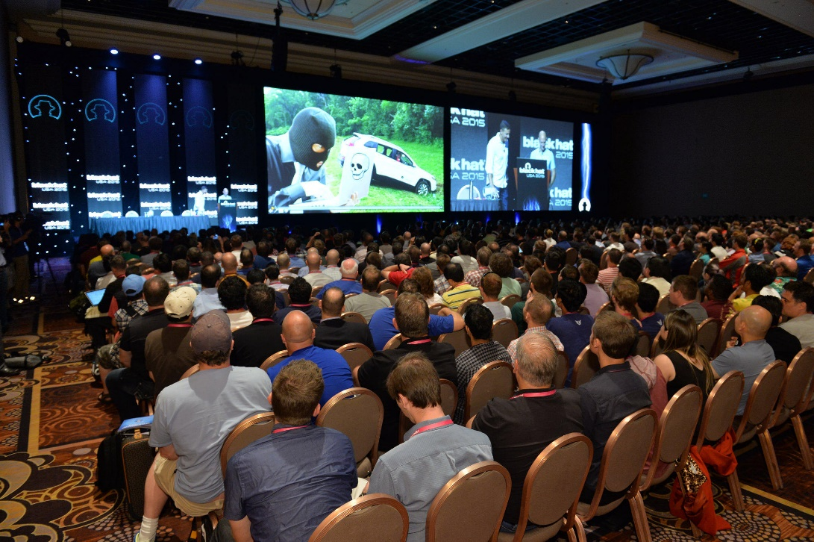
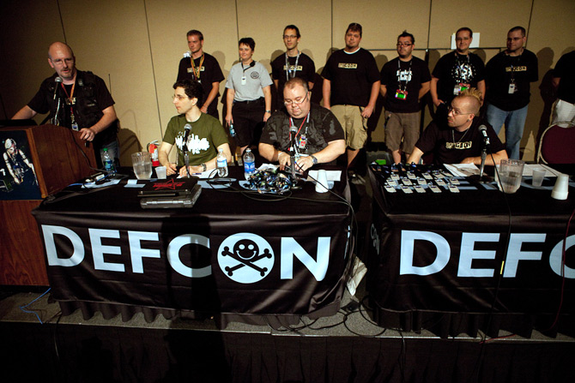
Hacking for fun
There’s the good, the bad, and the ones that do it for fun
Every year hackers meet and hack each other for fun
Hack conferences attract 1,000s around the world each year. Two of the most notable conventions are DEFCON and blackhat, which are both held back-to-back in Las Vegas, Nevada every year.
blackhat
July 2016
DEFCON
July 2016
Notes:
The blackhat conference is the go-to conference for the cyber security specialists. It attracts the corporate and federal IT security types, but there are attendees that will also attend DEFCON. This, ironically, is the true hacker convention. Whereas blackhat seminars will be serious and attended by company-sponsored employees (along with some of the actual blackhat community of hackers), the DEFCON conference is a cash-only event that is much more low key and radical. It’s cash-only to preserve the anonymity of the participants (who also don’t wear name tags with their actual names on them…..!).
Interesting fact: both conferences were founded by the same man, Jeff “Dark Tangent” Moss! Jeff has been involved in cyber security as a corporate white hat for most of his career and is still a security consultant in the field today.

Slide 19
The Attack Vectors (the hacks)

Slide 20
The history of hacking
Long time ago…
Little while ago…
Today
System
Network
System of Systems
If you insert this floppy disk into your desktop
If I can just get through this firewall and into the network
Your laptop, phone, home alarm, and bank are all connected?
Attacks across networks, devices, and systems
Attacks on a single computer
Attacks target networks of computers
Notes:
The evolution of hackers started with the old telephone system, mimicking a specific high pitched tone to access a long distance switching system.
The attacks moved to individual desktop devices connecting to each other via phone lines, hackers tried to randomly “break in” to other systems and devices.
From there, malicious code could be created and stored on external media, such as a floppy disk, and then loaded onto an unsuspecting desktop.
Key Point: Many of today’s hacks wouldn’t be possible without having moved to a System of Systems ecosystem.

Slide 21
Types of Attack Vectors
Fuzzing
Buffer Overflow
Password Cracking
Cross-site Scripting (XSS)
Software
Tailgating
Phishing
Social Engineering
Middleman Attack
Radio Frequency
Denial-of-Service
Network
Physical Modification
Glitching
JTAG/Debugging Port
Hardware
Notes:
Bullets in blue will be discussed on the following slides
Fuzzing – Fuzz testing is used to test a system for unexpected behaviors by passing random messages to an input in either a mutation or generation based method. The same approach can be applied to hack a system.
Buffer Overflow - a buffer overflow, or buffer overrun, is an anomaly where a program, while writing data to a buffer, overruns the buffer's boundary and overwrites adjacent memory locations. This is a special case of the violation of memory safety.
Password Cracking – attacks either on the password or the hash of a password. Often brute force is used with optimizations based on letter or word frequency in a given language used. Many optimizations are possible such as weaknesses is salted hashes.
Cross-site Scripting (XSS) – These attacks are a type of injection, in which malicious scripts (usually JavaScript) are injected into otherwise benign and trusted web sites. XSS attacks occur when an attacker uses a web application to send malicious code, generally in the form of a browser side script, to a different end user. Flaws that allow these attacks to succeed are quite widespread and occur anywhere a web application uses input from a user within the output it generates without validating or encoding it.
An attacker can use XSS to send a malicious script to an unsuspecting user. The end user’s browser has no way to know that the script should not be trusted, and will execute the script. Because it thinks the script came from a trusted source, the malicious script can access any cookies, session tokens, or other sensitive information retained by the browser and used with that site.
Tailgating - following people into a secure building by taking advantage of “holding the door open” behaviors.
Phishing – Sending emails appearing to be from trusted sources.
Middleman attack – an attack that reads messages or alters messages.
Radio Frequency (RF) – these attacks focus on weaknesses in wireless devices such as keyboards or card readers.
Denial-of-Service- flood a network or system with so many messages that the system or network is essentially down.
Physical Modification – the practice of inserting modified malicious hardware or replacing hardware with malicious hardware.
Glitching - Digital hardware devices almost always rely on a clock or master signal. By carefully monitoring the signals from an integrated circuit we can sometimes find ways to get the system into an unexpected state.
JTAG/Debugging Port - JTAG is the “Joint Test Action Group” standard for circuit level debugging. The JTAG allows programmers and attackers to alter the memory of the device, manipulate individual pins, and change the state of the device.

Slide 22
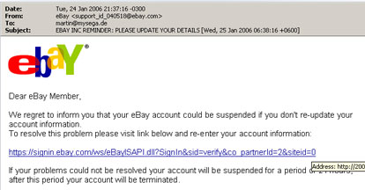
Phishing and SpearPhishing
Phishing is one of the most common attack vectors for hackers because of simplicity and scalability
1
2
3
Emails are sent to large # of targets impersonating another company
End users believe the legitimacy of the sender and clicking on embedded links
Target may (1) share personal information, such as bank login or (2) click links that download dangerous programs
Notes:
What: Phishing: the hacker is attempting to trick the target into releasing specific information by sending an email that closely resembles a legitimate organization. Ex: Fake emails from a bank that you used to bank with, saying that you have funds remaining in an account and they need your social security number or other identifying information via a clickable link to transfer these funds to you.
Spearphishing: When open source intelligence (OSINT– think about the public facts about you on social media – name, interests, location, etc ) is used to gather facts about you and those facts are used to create specific content that would increase your trust in the email you’ve received. For example: By looking at your public PB, LinkedIn and Pinterest profiles, we can glean that you are a Manchester United fan. And so sending you a contest entry for a VIP access to a behind the scenes Manchester United experience might entice you to click on the link for entry.
Why: It’s a fairly easy and unsophisticated attack: Replicate an old communication and add/create the identifying counterfeit logo, identify the target email addresses, create an email, add a link and landing page to grab the personal information, and an email from a proxy server.
How: How do you know if it’s real? Look at the URL of the link to see where you’ll be redirected. Is it HTTP or HTTPS? Is the link verified? And who is it verified for? When a browser is shipped, it’s shipped with root SSL certificates (ex Verisign or E-trust). Is the certificate on your email from a trustworthy source? Would you know if it is?
Examples:
eBay: because there have been so many attempts to phish through counterfeit eBay emails, they now have a page devoted to recognizing spoof websites and emails.
In April 2013, an In April, an AP journalist clicked on a spear phishing email disguised as a Twitter email. The phisher then hacked AP’s Twitter account. Stock markets plunged after a phony tweet about an explosion at the White House, erasing $136.5 billion of value from the S&P 500 index
The Puzzle: We’ve talked about SSL certs, but what if someone steals a root cert? Now we have infrastructure based on x509 chain trust, so this stolen cert looks alright. The puzzle then becomes -hHow do you check to see if a root cert is stolen?

Slide 23
Back to the bank heist
It all started with phishing emails
Getting access to system
Impersonating employees
Hackers sending phishing emails to bank employees
Virtually watched clerks interact with Cash Transfer Systems
Mimicked bank employees to transfer funds
1
3
4
Emails with exploits
Credentials stolen
$$$
100s of machines infected looking for admin PC
4 ways to dispense funds
2
E-Payment Systems
Inflating Accounts
Online Banking
Controlling ATMs
Found the admin
$ transferred to banks in China and US
Extra funds taken out of accounts and placed into hackers accounts
$ transferred directly into hackers accounts
Ordered ATMs to dispense $ at a predetermined time
Notes:
Phishing Scam that resulted in over $1B USD stolen from various financial institutions from over 100 banks and involving over 30 nations. One of the largest bank thefts ever! The transactions, limited to $10 million per transfer were conducted over a period of at almost 2 years.
The thieves spear phished (targeted) employees to install malware (called Carbanak) into the bank’s administrative systems. Once installed, it tracked bank employees’ movements allowing the hackers to learn, via video feeds and images, to learn daily routines and procedures. This enabled them, after months of observation, to mimic the activities of senior banking officials to transfer millions of dollars into dummy accounts in different countries as well as turn on cash (ATM) machines to dispense cash at specific times to be collected by members of the hacking gang.
Technologies involved:
Spear Phishing – bought access to the computers via Dark Web vendors. Once the employee opened the email, a Trojan as installed (variants of Anunak, Quadars and some Carberp hybrids, plus new ) that included keyloggers, data-stealing malware that led to privilege escalation and lateral movement into internal systems.
RAT – Remote Access Tool to collect video and screenshots
Infected computers attached to ATMs so the machines dispensed cash at the same time the gang’s mules were there to pick it up;
Compromised internal Oracle databases, created fraudulent accounts, issued cards and modified account balances to wire out more money each time;
Abused the Society for Worldwide Interbank Financial Telecommunication system to move large amounts of money into accounts they controlled;
Used the online banking vector for e-pay fraud and fraudulent transactions.

Slide 24
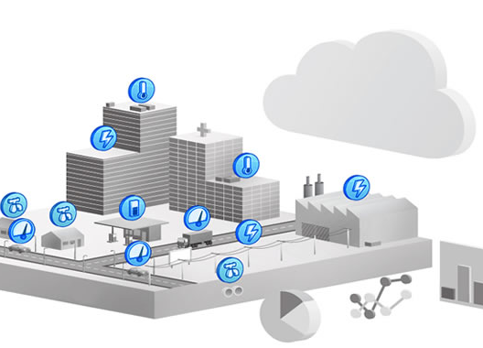
IoT Hacks
With the rise of Internet of Things, security vulnerabilities are exponentially increased as there are more device entry points
Enterprise Setting
Consumer setting
Systems and devices are connected across the enterprise, enabling efficiencies and business analysis capabilities
Consumers’ systems and devices are synced together with the help of the cloud
Notes:
The Internet of Things: the interconnection of our lives and our stuff. Appliances, security systems, cars, fitness trackers – these are all tied into the web. We are obsessed with the monitoring of our stuff! Hackers know this: and they are starting to disrupt the flow of accurate information.
There have been stories of attempted hacks into aircraft in flight.

Slide 25
IoT Hacks at Target
A major US retailer, Target, hired a 3rd party vendor to connect each stores’ HVAC (air conditioning system) to the corporate network.
Hackers steal HVAC passwords from vendor, then break into Target’s network.
$
Hackers able to steal credit card information from Target customers
HVAC
Notes:
What:
Hackers are able to get into IoT devices via multiple entryways. They can remotely control your car, your refrigerator, the lighting in your home… maybe unlock your front door?
Why: Theft, manipulation, just because they can? Hackers do what they do for a variety of reasons, sometimes to prove that they can take control. “In a recent survey conducted by the FOW Community, leading IT companies predicted that between 26 and 212 billion devices will be connected to the web by 2020. That means devices will outnumber the human population by at least a factor of three.” – David Bisson, 11/3/14, Tripwire.com. Webcams, automobiles, refrigerators, printers and medical devices have already proven that they can be hacked.
Examples:
Target - their HVAC vendor tied the system into their corporate network so that the system could be monitored. Then hackers stole a password from their HVAC (third party) vendor, and navigated their way into Target’s customer financial records and STOLE CUSTOMER CREDIT CARD information! The initial hack was into the HVAC system – and since the environmental controls was linked to the corporate network, instead of on an isolated network, it became relatively easily to cross navigate cross system and help themselves to the credit card data.
2014 – remote hacking of a 2014 Jeep Cherokee: Two security researchers demonstrated that they could hack into a 2014 Jeep Cherokee to disable it’s transmission and brakes. The result: Fiat Chrysler issued a 1.4 million vehicle recall to patch the software AND block the any attack on the Sprint (US Cellular Carrier) network that was used to connect it’s vehicles.
Tesla’s Model S was also used as an example of where a hacker could use a laptop to start, and drive off with, the car. In another example a remote-access Trojan virus was installed and could remotely shut the engine down while driving.
Printers: a Canon Pixma Printer was hacked and it’s web proxy settings and DNS server. Not a big deal until you think about someone stealing your personal documents as you send them to the printer! What is the value of a printer in your day to day use? What do you print that you wouldn’t want someone to get their hands on? What about your printer at work or school?
Back in 2007, Dick Cheney, then Vice President of the United States, needed a pacemaker installed due to his heart health. He had the wireless connection disabled out of fear that a terrorist organization could hack in and harm him by speeding up or slowing down his heart rate.
The Puzzle: Find a way to isolate an IoT device or authenticate access to prevent unauthorized disruption .

Slide 26
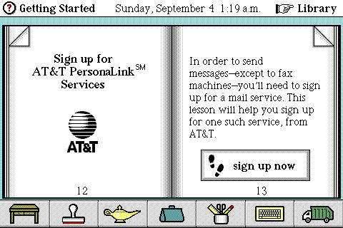
Origins of the cloud
The goal of the cloud was to connect people and data from anywhere in the world at any time
1983 – CompuServe attaches computers together to create shared storage
1994 – AT&T created first online-only platform for business. Slogan was “you can think of our electronic meeting place as the cloud”
Today – The cloud has evolved encompass much more than storage, and cybersecurity is more important than ever.
Microsoft Azure
Dropbox
Pinterest
Amazon Web Services

Slide 27
Today’s Cloud addresses cybersecurity
The app you build in the cloud has built-in security
Security Features
Security embedded in systems and software (SDL)
Centralized monitoring and logging
Up-to-date software & patch management
On-call incident response team
Sophisticated intrusion detection controls
Notes:
All features of Azure

Slide 28
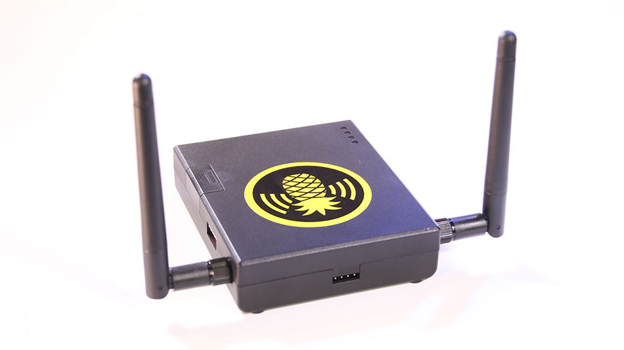
Wireless auditing
The Wi-Fi Pineapple is a creative way for hackers to tap into your personal devices
1
Intercept signals of nearby devices looking for Wi-Fi
2
Duplicate the network names, so devices connect automatically
3
Your device shares any saved login information (Facebook, bank accounts, etc.)
WiFi Pineapple
Notes:
The ability for hackers to “eavesdrop” in on your internet activity is another easy way to be vulnerable. You’re sitting in a coffee shop , or at the airport, and need to transfer money between two of your bank accounts or pay a bill. Should you?

Slide 29
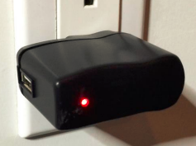

Hardware surveillance
Several physical devices that discreetly monitor computer activity
The KeySweeper acts as a USB charger, but also allows Wi-Fi monitoring and keystroke recording
The KeyGhost is placed discreetly in the back of a desktop in the Ethernet port
Notes:
The USB that records everything you type http://thehackernews.com/2016/05/usb-charger-keylogger.html

Slide 30
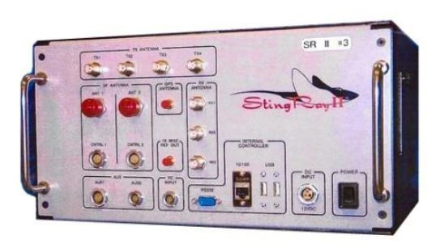
Cell phone surveillance
StingRay has become the generic term for devices that can monitor cell phone usage
1
Device mimics a cell phone tower
2
Phone connects to StingRay because of perceived greater signal strength than other network towers
3
StingRay can track all activity including location of mobile phone
StingRay

Slide 31
SQL Injection Attack
SQL, Structured Query Language, is the lingua franca of relational databases.
Basic SQL Syntax:
Web forms likely have a SQL Database that stores user information
Create Table Student
(
id integer,
first_name char(50)
last_name char(50)
);
--creates a tabular store named Student
Update Student (Set first_name=‘Sal’);
--updates all records to first_name of ‘Sal’.
Users access these tables when they setup an account or want to change their demographic data
When a SQL Database isn’t structured correctly, users can manipulate a table using commands in the input field
Now, imagine what could go wrong with a web form that saves data to a database if the form’s input fields were mapped to SQL in a naïve way.
Notes:
What: SQL Injection is a very easy to perform attack. If an application (web form or any app) does not check the input fields of a form then this attack is possible. For instance, if a form was created for the above table to update a students name like this:
SQL = “Update Student”
SQL + SQL = “SET first_name = “ + ISNULL(txtFirst_Name, ‘’) ,”
SQL + SQL = “last_name = “ + ISNULL(txtLast_Name, ‘’);”
Here is the value of SQL in a typical usage:
SQL = “Update Student SET first_name = ‘Sally’, last_name = ‘Jones’;
The form, if written incorrectly will execute the string in the SQL variable directly against the database.
Puzzle:
If I told you that “DROP TABLE table_name;” is a valid SQL command which upon execution will drop the table in the ‘table_name’ position.
Can you think of how such a form could be exploited?
Ans: All the user/hacker would have to do is type into the first_name field is:
‘); Drop Table Student; --
or
; Drop Table Student; --
Explanation:
We first need to close the SQL statement that the form is attempting. The way to terminate a command is ; semicolon. We might need to close a server side function looking for the string boundary so we might need ’); to tell the getRequestString() type function.
We then inject the commend. Here we are injecting a command to drop the student table.
Finally, to ensure we pass syntax checks on the SQL query engine, we need to terminate the SQL command we injected and we need to force the query engine to ignore any SQL fragments that will be in the string from the form. So we add ;--.

Slide 32

Story of Little Bobby Tables
Created by Randall Munroe

Slide 33
SQL Injection Attack: Countermeasure
Example code that prevents SQL Injection hacking
Question: How can we best block a SQL Injection Attack?
String query =
"SELECT account_balance FROM user_data WHERE user_name = ?";
try {
OleDbCommand command = new OleDbCommand(query, connection);
command.Parameters.Add(new OleDbParameter("customerName", CustomerName Name.Text));
OleDbDataReader reader = command.ExecuteReader();
// …
} catch (OleDbException se) {
// error handling
}
Answer: As long as the site uses a modern type-safe language, you’re safe.
Examples include:
Java EE
.NET
PHP
Hibernate
Notes:
How can we best block a SQL Injection Attack?
It’s easy. Most modern languages will handle this hack.
Modern type-safe languages like C# are built on frameworks like .Net which provide database access libraries that wrap database stored procedure calls in functions that block termination or closure of an input.
Safe languages include:
Java EE – use PreparedStatement() with bind variables
.NET – use parameterized queries like SqlCommand() or OleDbCommand() with bind variables
PHP – use PDO with strongly typed parameterized queries (using bindParam())
Hibernate - use createQuery() with bind variables (called named parameters in Hibernate)

Slide 34
Cracking a Password
Notes:
Having your password compromised is likely an experience that many in this room have already encountered, especially if you use the same passwords across multiple websites, like social media sites you belong to as well as banking websites.
Let’s look at how these passwords are cracked and how individuals and companies can prevent it from happening.

Slide 35
Can passwords be cracked?
Before understanding how a password can be broken, you must understand its components.
Passwords are not plain text anymore, instead a ‘hash’ is used.
What’s a hash?
Hashing is a method to convert passwords into a fixed length string of characters using an algorithm. The resulting string is referred to as a “fingerprint”.
So my password, “hello” is something more complicated?
Using the SHA-256 hash, “hello” becomes:
2cf24dba5fb0a30e26e83b2ac5b9e29e1b161e5c1fa7425e73043362938b9824
Notes:
Modern OSs never store plain-text passwords
Instead they use a hash function which is a one-way encryption to produce a fixed length “ hash”
One-way encryption means the password cannot be derived from the hash
There are many different hash functions: LM, NTLM, md2, md4, md5, md5_hex, md5-half, sha1, sha224, sha256, sha384, sha512, ripeMD160, whirlpool, etc.
Hash algorithms create a "fingerprint" that cannot be reversed. They also have the property that if the input changes the resulting hash is completely different
Question: Do you believe these are hashes are secure?

Slide 36

Brute force can break passwords
Brute Force is what it sounds like: cracking a password through trial and error
Short passwords are easier to break
Brute Force works best with offline systems that do not have limitations on incorrect password entries
Modern GPUs are ideal for repetitive tasks, such as password hacking
Can this be effective?
Notes:
Modern OSs never store plain-text passwords
Instead they use a hash function which is a one-way encryption to produce a fixed length “ hash”
One-way encryption means the password cannot be derived from the hash
There are many different hash functions: LM, NTLM, md2, md4, md5, md5_hex, md5-half, sha1, sha224, sha256, sha384, sha512, ripeMD160, whirlpool, etc.
Hash algorithms create a "fingerprint" that cannot be reversed. They also have the property that if the input changes the resulting hash is completely different
Question: Do you believe these are hashes are secure?

Slide 37
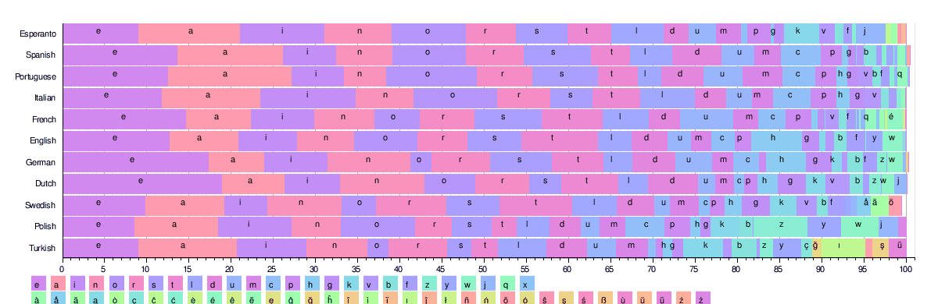
Brute force is optimized with a Rainbow Table
The use of a Rainbow Table will dramatically speed up the time to uncover a password
A Rainbow Table looks at patterns across a language to optimize its searches using high frequency characters first.
Rainbow Tables are large sets of precomputed tables filled with hash values that are pre-matched to possible plaintext passwords
Brute Force with a Rainbow Table can be very effective depending on the password length.
Notes:
If you had a pre-compiled list of all possible hashes for a given hash function, then you could compare the hashes only. Such a list of passwords and hashes is known as a Rainbow Table.
A brute force attack against a naïve hash using a Rainbow Table can be very effective and fast.
Hackers and researchers take advantage of leaked passwords to optimize their Rainbow Tables based on patterns they see in these leaked password lists.

Slide 38
Countermeasure #1: Put some salt on it
Salting a password adds an additional layer of protection
Unsalted (less safe)
Salted (more safe)
SHA-256_hash ("hello“ + "QxLUF1bgIAdeQX") =
9e209040c863f84a31e719795b2577523954739fe5ed3b58a75cff2127075ed1
SHA-256_hash ("hello“) =
2cf24dba5fb0a30e26e83b2ac5b9e29e1b161e5c1fa7425e73043362938b9824
Salt
User Password:
“happy”
Hash Value
9e209040c863f84a31e719795b2577523954739fe5ed3b58a75cff2127075ed1
Salt:
QxLUF1bgIAdeQX
Hash Algorithm
Notes:
A salt size of 128 bits is common on modern OSs.
Salt is related to the Cryptographic concept of nonce.
If the password file is salted, then the rainbow table would have to contain "salt . password" pre-hashed. If the salt is long enough and sufficiently random, this is very unlikely. Unsalted passwords chosen by humans tend to be vulnerable to dictionary attacks since they have to be both short and meaningful enough to be memorized.
Salt is generally generated using Cryptographically Secure Pseudo-Random Number Generator (CSPRNG).
Microsoft’s implementation can be found here:
https://en.wikipedia.org/wiki/CryptGenRandom
.Net
System.Security.Cryptography.RNGCryptoServiceProvider

Slide 39
Countermeasure #2: Key Stretching
Slowing down the hashing function makes brute force method more time consuming
Salting a hash helps but today’s graphics cards (GPUs) and custom hardware can compute billions of hashes per second.
Key Stretching is one technique to slow down the hashing function.
Key Stretching is typically implemented using special types of CPU-intensive hash functions which have no known optimization.

Slide 40
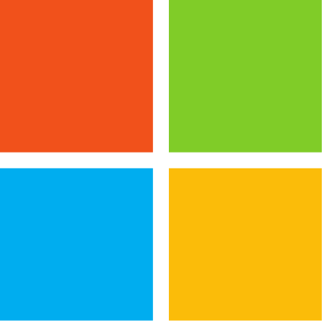
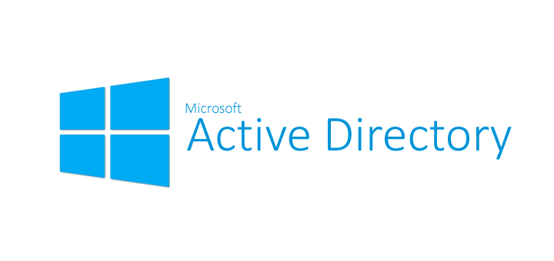
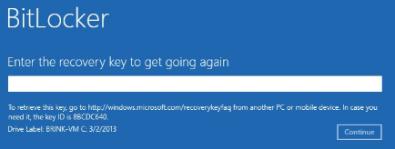
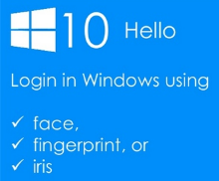
Countermeasures #3-5
Microsoft products have several features that provide an extra level of password security
#3 Domain Policies
#4 Disk Encryption
#5 Multi-Factor Authentication
Modern OSs such as Windows in enterprise environment have domain policies. A domain policy allows a central administrator to enforce custom password polices.
Modern OSs such as Windows offers disk based encryption. Bitlocker’s full disk encryption helps prevent off-line attacks.
Multi-Factor Authentication (MFA) requires multiple levels of security. Windows Hello is an excellent example of modern MFA.
Notes:
Modern OSs such as Windows in enterprise environment have domain policies. A domain policy allows a central administrator to enforce password polices: minimum password length, UPPER case, numbers, and special characters. They also can force users to change passwords regularly and prevent users from re-cycling old passwords.
Modern OSs such as Windows offer disk based encryption. Bitlocker’s full disk encryption helps prevent off-line attacks.
Multi-factor Authentication (MFA) is an increasingly important measure as well. MFA requires a password and a code generated by a device such as a smart phone. A hacker would have to have both devices.

Slide 41
Countermeasures (countering the hack)

Slide 42
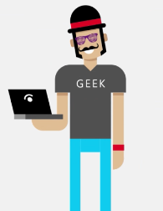
How do we best protect ourselves?
Risk Assessment
Data Governance Policy
Audits
What services are high risk?
Is there PII in the data?
What data should be considered sensitive?
Any data that is critical to business function?
Is data governance being applied correctly?
Test and retest periodically
Threat Assessment
Product features that enhance security
Who is likely to attack us?
What are the probable attack vectors?
Personal authentications, such as Windows Hello
End-to-end data encryption
Virtual smartcards and two-step authentications
Do we need firewalls? Blocking ip from countries
Notes:
Plug Windows “Hello” feature (login with face scan or fingerprint):
Windows Hello is a more personal, more secure way to get instant access to your Windows 10 devices using fingerprint or facial recognition. Surface Pro 4, Surface Book, and most PCs with fingerprint readers are ready to use Windows Hello now, and more devices that can recognize your face and fingerprint will be available in the future.
Plug Z Factor Authentication by Windows
We’ve moved beyond just firewalls and endpoint security towards intrusion detection; threat evaluation;
Geolocation is also an issue –
Disclosure requirements – once you’ve been hacked
Forensics requirements – to preserve a hacked environment
Audits – looking at the policies around your environment

Slide 43


A move to detection and response
Industry focus is shifting to detecting and responding to cyber hacks
The average time to detect malware was 205 days, and 69% were discovered by external parties, not internal IT departments
Perfect protection is not possible
By 2020, 60% of enterprise information security budgets will be allocated for rapid detection and response approaches, up from less than 20% in 2015.
Notes:
IT professionals are starting to understand that 100% protection is not possible.
Rather than a focus on protection, focus is shifting to detecting and responding to malicious incidents.
Currently, the security industry is not very good at recognizing breaches as evidenced by the data:
The average time to detect malware was 205 days, and 69% were discovered by external parties, not internal IT departments
By 2020, 60% of enterprise information security budgets will be allocated for rapid detection and response approaches, up from less than 20% in 2015.

Slide 44
Surfing the wave of cyber crime
Notes:
The goal of the White Hat is to surf the cyber wave just in front of the Black Hats. To stay just in front of the next black hat hack, to out-think, if not out-maneuver, the next bug hack.
How can you create the next invisible target? By starting to focus on learning what cyber security is today and understanding what it needs to be tomorrow, in order to surf the wave and stay ahead of the momentum behind you.

Slide 45
Opportunities are vast
Career opportunities are wide-reaching. Consider joining the fight against cybercrime.
Risk Assessment
Data Gov. Policies
Audits
Protection
Strong password policies
Firewalls
Network Segregation
IT Operations Analytics
Detection
Disaster Recover Plan
Rehearsed what to do
Insurance
Regulatory Awareness
Response
Notes:
There are many different ways to enter and navigate a career in cybersecurity. There are lots of opportunities to focus on the aspect of cybercrime that most appeals to you.

Slide 46

Your next steps
Get even more curious and learn more…
Join a local Microsoft Student Partner group
Consider an Imagine Cup project in cybersecurity
Notes:
So, I’ve told you some stories, asked you some questions and hopefully taught you something about a specific type of hack that we need to prevent. The black hat community is out there, and able to negatively affect your finances, credit, history or reputation.
We are in need of someone just like you to help us to reduce the amount and severity of cybercrime on a level that can sometimes feel too hard to manage. There’s no direct route beyond your own curiosity, no specific path and no list of “must have” certifications. This is a real and growing problem in need of solutions.
You can be the one to create an invisible target through a career in cybersecurity. Can you solve the puzzle?
Next steps:
Want to compete to win cash and prizes? The Imagine Cup is a global student technology program and competition that provides opportunities for students across all disciplines to team up and use their creativity, passion and knowledge of technology to create applications, games and integrate solutions that can change the way we live, work and play. Be the first to start a Cybersecurity-focused technology!
Want to be the Tech Guru on your campus? The Microsoft Student Partners (MSPs) are student technology leaders, empowered to build Microsoft communities on their campus and share their deep knowledge and passion for technology with their fellow classmates.
Spanning more than 100 countries around the world, MSPs receive: Leadership Experience – Host fun workshops, run hackathons, and give demos on campus to grow a community of students.
Resume Building - Enhance their promotional skills, add to their professional technology experience, and work alongside Microsoft professionals.
Exclusive Access – Receive insider training, exposure to career opportunities, and access to the latest technology events.

Slide 47
References
Industry Reports
The Insider’s Guide to Cybersecurity for Government! (Microsoft)
M-Trends 2015: A View from the Front Lines (Mandiant)
Shift Cybersecurity Investment to Detection and Response (Gartner)
2016 Data Breach Investigations Report (Verizon)
News
thehackernews.com
http://www.zdnet.com/article/getting-started-with-a-career-in-cybersecurity/
https://www.wired.com/2016/05/maksym-igor-popov-fbi/
http://resources.infosecinstitute.com/a-history-of-anonymous/
https://www.wired.com/2015/12/2015-the-year-the-internet-of-things-got-hacked/
http://krebsonsecurity.com/2014/02/target-hackers-broke-in-via-hvac-company/
https://www.wifipineapple.com/
http://www.idtheftcenter.org/Cybersecurity/how-wifi-hotspot-hacks-occur.html
https://www.washingtonpost.com/news/the-switch/wp/2014/12/18/the-sony-pictures-hack-explained/
http://fortune.com/sony-hack-part-1/
http://www.bbc.com/news/entertainment-arts-30512032
http://www.computerworld.com/article/2474275/cybercrime-hacking/17-exploits-the-nsa-uses-to-hack-pcs--routers-and-servers-for-surveillance.html
http://resources.infosecinstitute.com/a-history-of-anonymous/
https://www2.deloitte.com/content/dam/Deloitte/lu/Documents/risk/lu-managing-social-media-risks-reputation-risk-03032015.pdf

